Slide 1



A Provenance assisted Roadmap for Life Sciences Linked Open Data Cloud
Ali Hasnain et. al
Insight Center for Data Analytics
National University of Ireland, Galway

Slide 2
Agenda
Motivation
Linked Life Sciences Roadmap
Cataloguing and Linking
Extending Catalogue – Metadata & Provenance
Query Engine
Results

Slide 3
Motivation
Biomedical Data is heterogeneous and spread across multiple sources (SPARQL endpoints).
Navigation is a challenge.
Containing trillions of triples and represented with insufficient vocabulary reuse.
Biologists sometimes want to get more information regarding the data including its source, creator, publisher and also statistics with respect to its size (Metadata & Provenance).

Slide 4
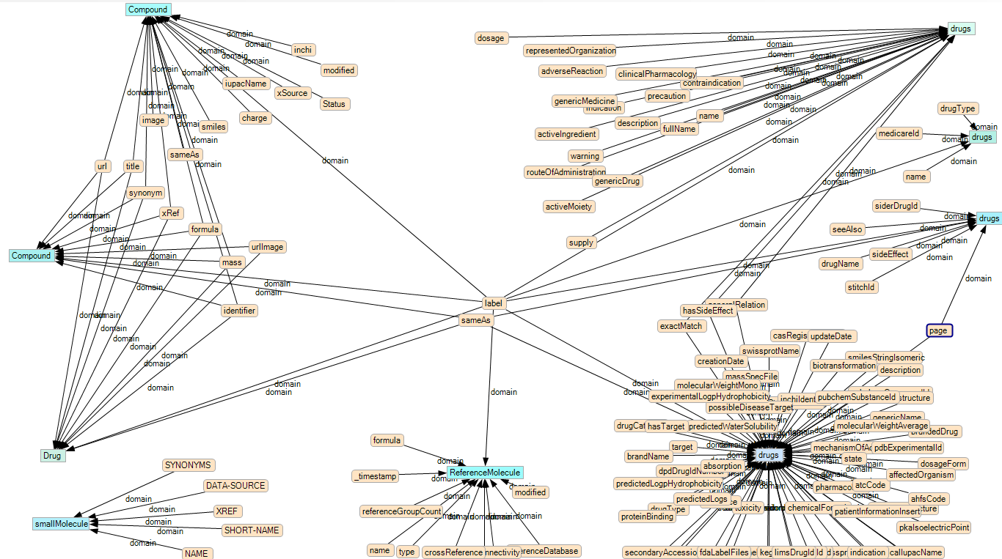
How to deal heterogeneous data?
DailyMed
Medicare
CheBI, KEGG
Sider
DrugBank
BioPax
Reactome
Notes:
M: part of the challenge lies in the fact that, even though multiple datasets talk about the same concepts, they don’t use the same terminologies. Both the URI are different, and so are the labels.
-> In Granatum, we enable drug discovery by addressing this problem in linked open data

Slide 5
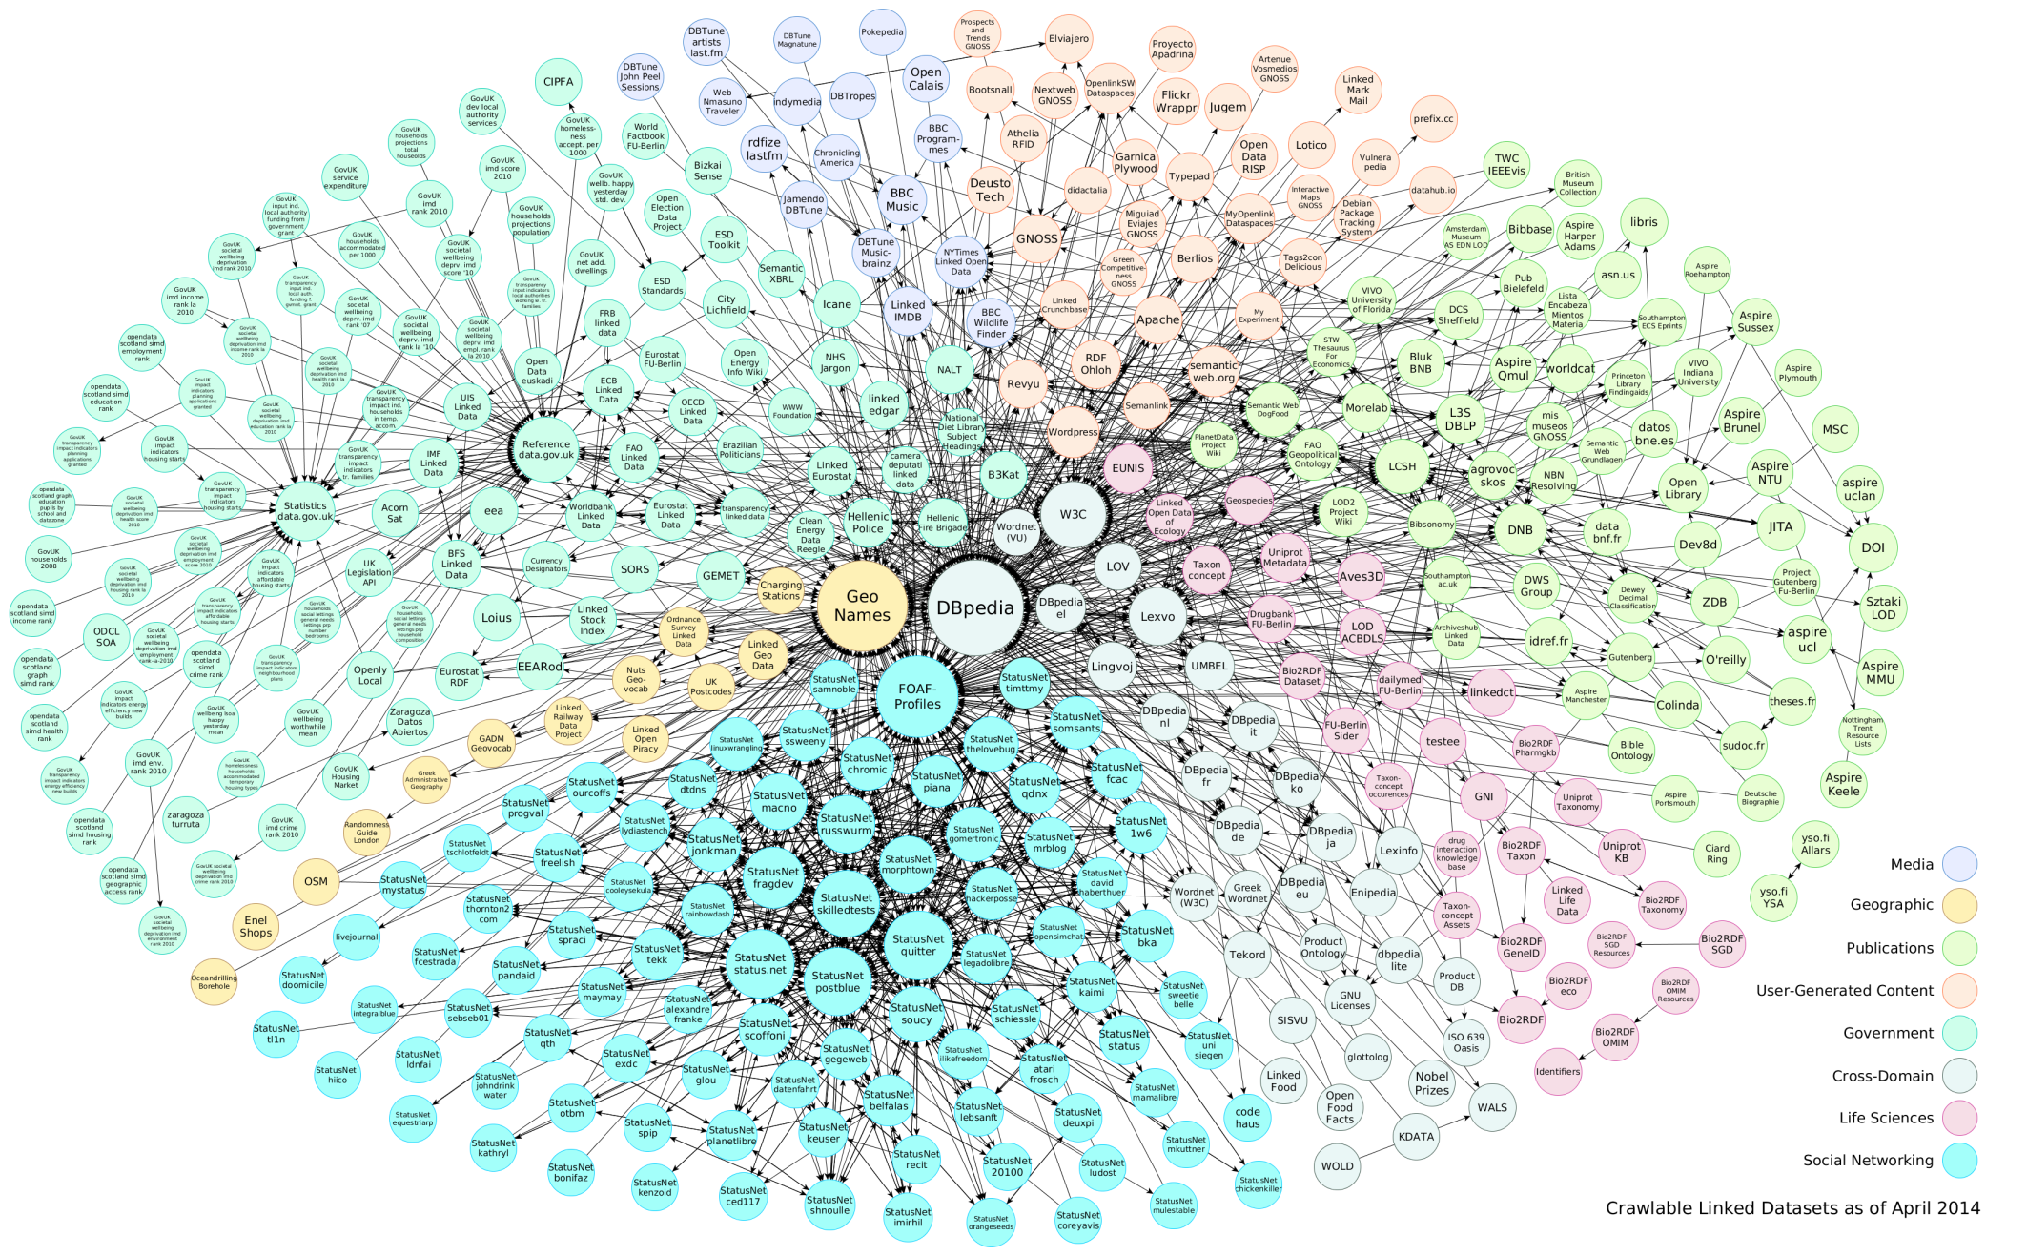
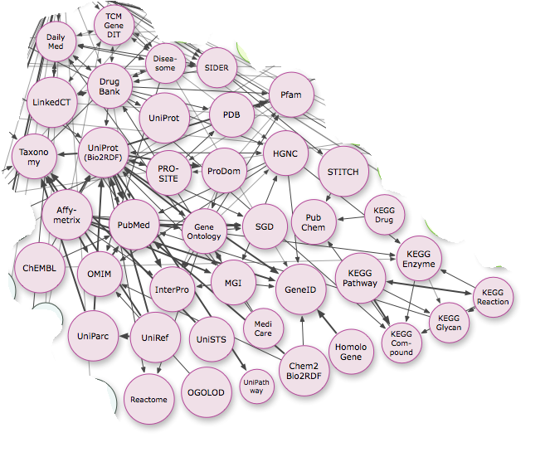
We want to query the content, not the source
Proteins
Molecules
Genes
Diseases
Notes:
M: the way linked data is organizes still forces us to lookup data by its location, not the content! But those who turn to linked data don’t want to query “PDB”, they want to learn more about proteins, or genes, etc
-> Our first task is to catalogue the concepts that are relevant in these various datasets. Proving a common access for data is the first pillar on the bridge that crosses the valley of death

Slide 6
A Linked Life Sciences Roadmap
Proteins
:Protein
:Molecule
Molecules
UniPark
Uniref
Daily
med
Genes
PDB
Drug
Bank
ChemBL
Uniprot
ProDom
Diseases
Pfam
PROSITE
Pub
Chem
KEGG
:Gene
MGI
:Disease
Homo
gene
Disea
some
Affy
metrix
SIDER
GeneID
Gene
Ontology
Notes:
M: when data is catalogues, we can discovering new links by crossreferencing with existing datasets
-> once we identify these concepts, how do we actualy query them toegether?

Slide 7
2- Possible Solutions
To assemble queries over multiple graphs at multiple endpoints, either:
vocabularies and ontologies are reused, Or
translation maps between different terminologies are created (“a posteriori integration”)

Slide 8
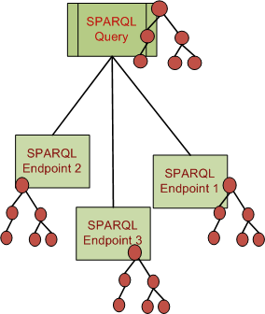
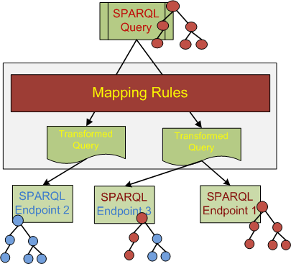
a-priori v.s a-posteriori Integration

Slide 9
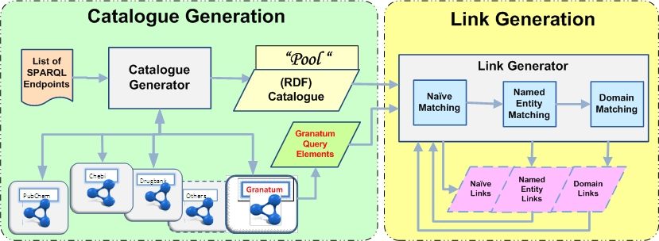
Cataloguing and Linking

Slide 10
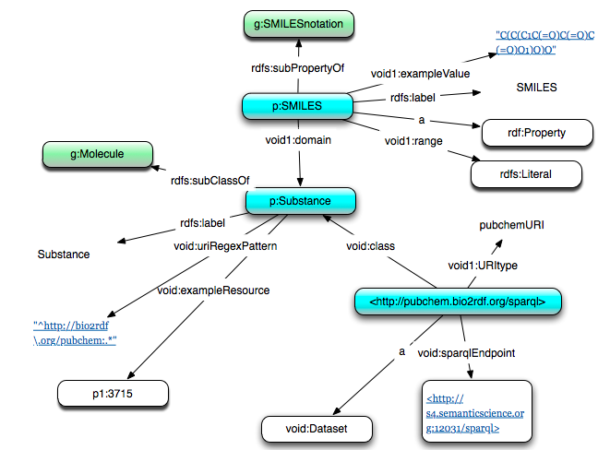
Describing DataSets- an Extract from Catalogue

Slide 11
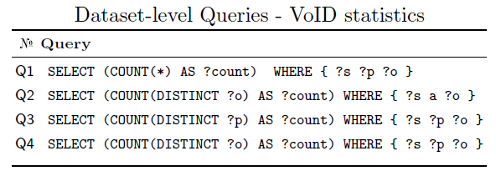
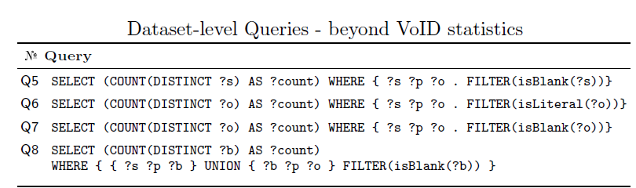
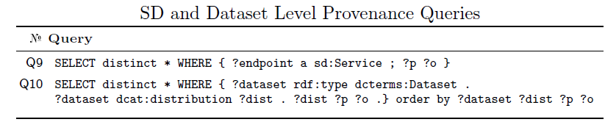
Extending Catalogue – Metadata & Provenance

Slide 12
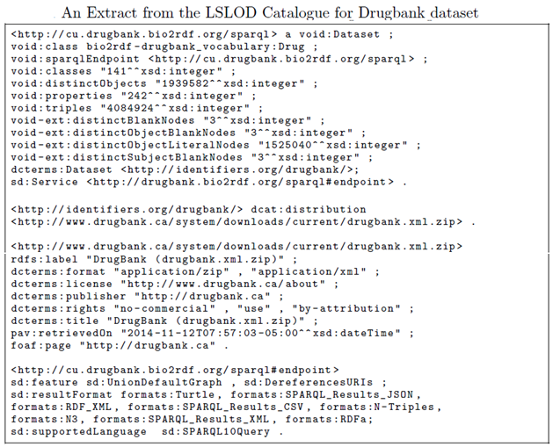

Slide 13
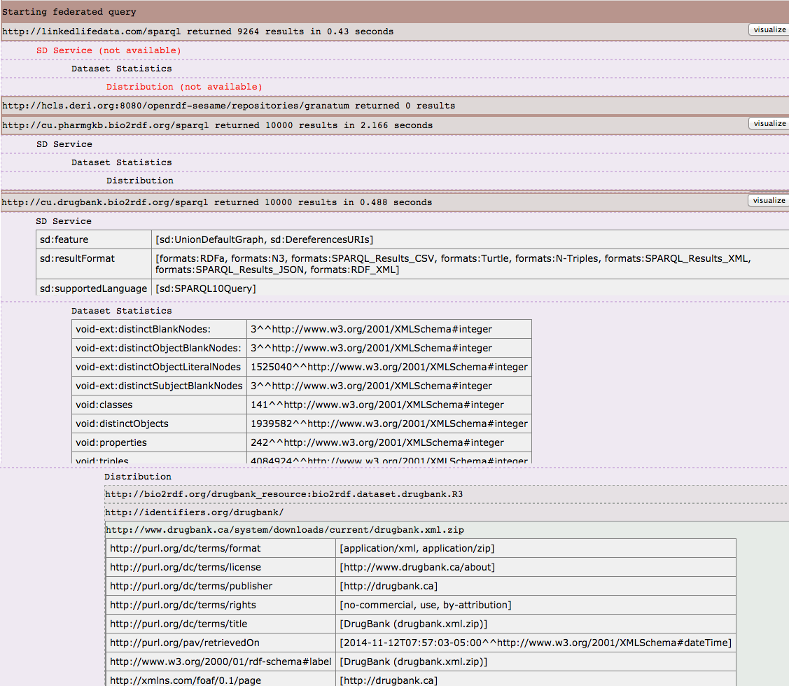
Notes:
Represents a specific available form of a dataset. Each dataset might be available in different forms, these forms might represent different formats of the dataset or different endpoints. Examples of distributions include a downloadable CSV file, an API or an RSS feed

Slide 14
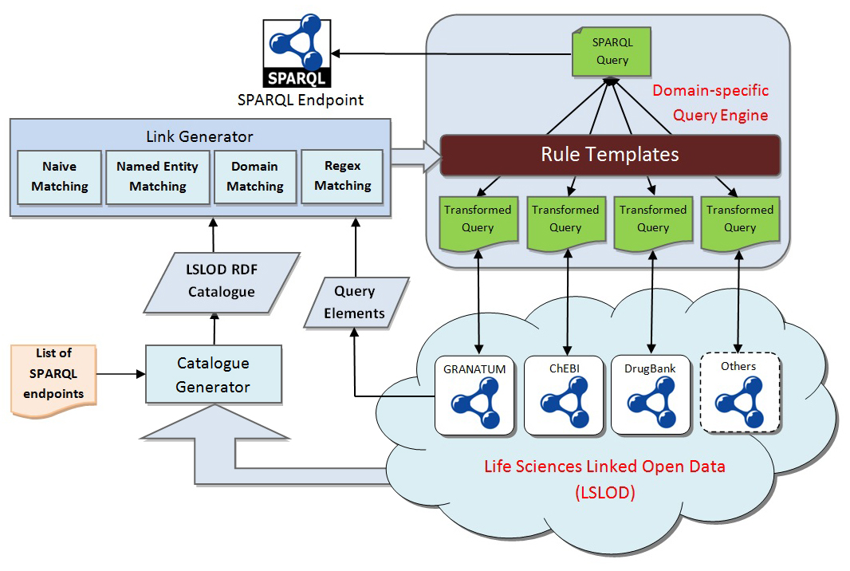
Query Engine
http://srvgal86.deri.ie:8000/graph/Granatum

Slide 15
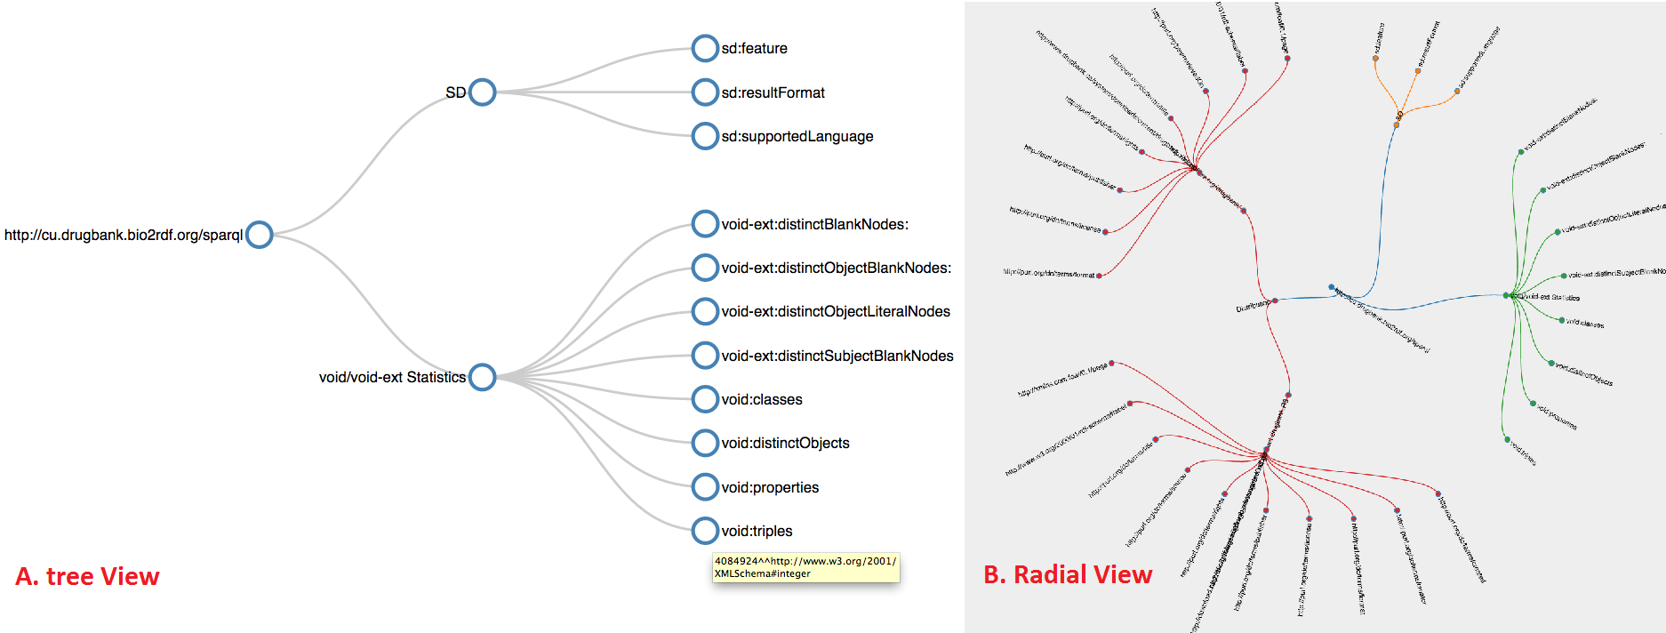
Visual & Graphical View

Slide 16
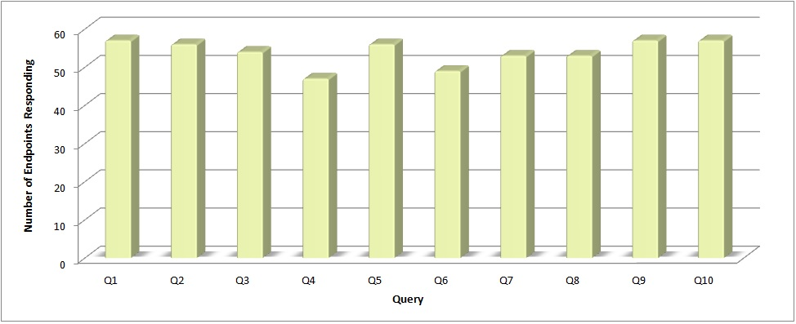
SPARQL Endpoints returning results per query

Slide 17
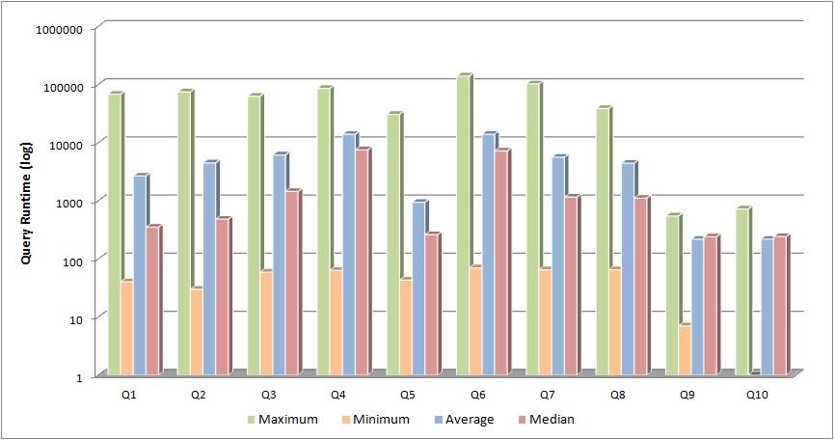
Runtimes taken by different queries (Max, Min, Average, Median)

Slide 18


